Slide 1
Joint Problem-Solving Discourse Chat-room (JPSD Chat-room), An Environment to Investigate: Monitoring, Evaluating and Supporting online group collaboration. By: Adeniran Adetunji, PhD Student, Computing Science Department University of Aberdeen.

Slide 2
JPSD Chatroom Purpose and Context
Acceptance of online learning continues to increase as a way of providing education to numerous and geographically dispersed students and prospective students that might otherwise be limited in accessing a traditional classroom learning environment [1]. It is thus important to provide e-learning platform with features obtainable in traditional classroom. One of this feature is group learning.
We present here the design framework of an experimental system for a real-time monitoring and evaluation of group collaboration during joint problem-solving (JPS), to support studies in this area of research.
Our system is a database driven web application using PHP, Javascript, Ajax with PosgreSQL databased power by Heroku.

Slide 3
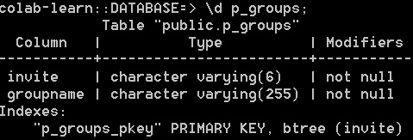
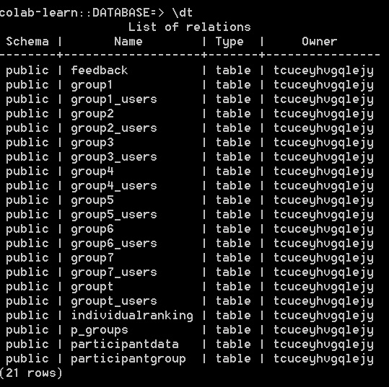
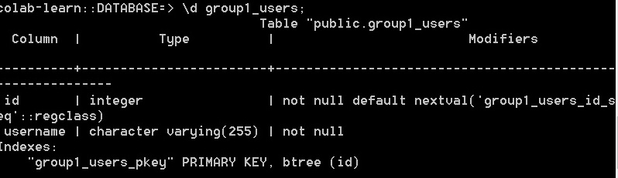
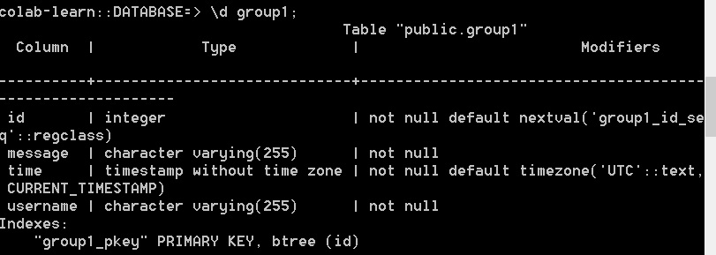
JPSD Chat-room System Database and Tables
group1_users,…groupN_users | N= number of groups
group1,…groupN | N= number of groups

Slide 4
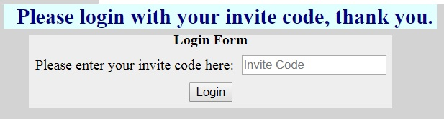
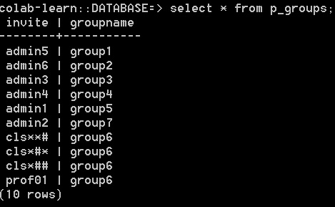
JPSD Chat-room Login 1
p_groups is populated with “invite_code” which authenticates the use for a specific group. Each unique code is attached to a group, which form the p_groups table. See example:
require: loginScript :=> database
if button[login] :=clicked
username:=getTextFrm[texbox]
if: username:=null
alert:= “enter username”
else:
if: username isNot in p_groups
alert:= “enter correct username”
else:
groupName:= p_groups.groupname where
p_groups.invite :==username
start session
session.username:=username
session.groupname:=groupName
goTo; nextPage:=groupChatLogin.php
See code@ https://github.com/colabLearn/colabLearn.github.io/blob/master/participantLogin.php

Slide 5
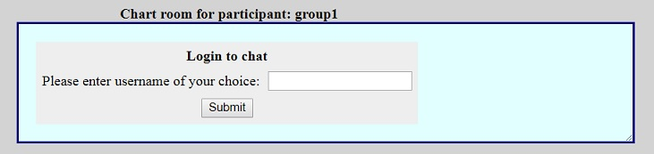
JPSD Chat-room Loging 2
if: currentUser in currentG
alert:= “nickname in use, use another
nickname”
else: Insert currentUser INTO currentUserG
start session
session.username:=user
session.groupname:=grp
session.currentG:=currentG
goTo; nextPage:=chatroom.php
See complete php code @
https://github.com/colabLearn/colabLearn.github.io/blob/master/groupLogin.php
Start session
If: session.username isSet AND
session.groupname isSet
user:= session.username
grp := session.groupname
currentG:=grp.”_users”
if: button[submit]:=IsClicked
currentUser:= getValue[groupLogin.textbox]
if: currentUser:==Null
alert:= “Enter nickname for group chat”
else:
require: loginScript :=> database

Slide 6
JPSD Chat-room Interface framework
Parent frame, chatroom.php
Group Joint Problem-Solving Chat-room
Child1 frame, newMessage.php
Child2 frame, sidebar.php
c1Frame.div1
c1Frame.div2
c2Frame.div
c1Frame.textBox
c1Frame.chatButton
c1Frame.endButton

Slide 7
JPSD Chat-room System Algorithm 1
Chatroom.php:
Session start
If: session.username isSet AND
session.groupname isSet AND
session.currentG isSet
user:= session.username
grp:= session.groupname
currentG:= session.currentG
Function endChat:
delete username from currentG
goTo; nextPage:=thanks.php
See code @
https://github.com/colabLearn/colabLearn.github.io/blob/master/chatroom.php
user:= session.username
grp:= session.groupname
Function submitChat:
username:=user
group:=grp
msg:=getValue[c1Frame.textBox]
xmlhttp = new XMLHttpRequest
if: xmlhttp IsReady AND xmlhttp fetchRequest
c1Frame.div:= xmlhttpResponse
xmlhttpRequest:
GET insert.php := username&msg& group
Send[xmlhttpRequest]
=============================================
Insert.php
user:= xmlhttpRequest_GET[username]
msg:= xmlhttpRequest_GET[msg]
groupName:=xmlhttpRequest_GET[group]
require: loginScript :=> database
query1: insert INTO groupName (message, username)
VALUES (‘msg’, ‘user’)
newMessage.php:
Session start
If: session.username isSet AND
session.groupname isSet AND
session.currentG isSet

Slide 8
JPSD Chat-room System Algorithm 2
=============================================
query2:= Select ALL from groupName
rowsReturned:= fetchAllRow[query2.result]
xmlhttpResponse:=rowsReturned[username]:rowsReturned[grp]
See code@
https://github.com/colabLearn/colabLearn.github.io/blob/master/insert.php
=================================================
….. newMessage.php
c1Frame.div :=Ajax.load[ grp.php] @ 2 second intervals
=================================================
grp.php
require: loginScript :=> database
query:=Select ALL From Table grp
rowsReturn:= fetchAllRow[query.result]
display:=rowsReturn[username].:.rowReturn[message]
See code e.g. grp := ‘group2’@
https://github.com/colabLearn/colabLearn.github.io/blob/master/group2.php
==========================================
….. newMessage.php
clear[c1Frame.textBox]
end[submitChat]
scroll. c1Frame.div ToEnd @ 2 second intervals
If c1Frame.chatButton: IsClicked
execute submitChat
if c1Frame.endButton:=IsClicked
execute parentFrame.endChat
See code@ https://github.com/colabLearn/colabLearn.github.io/blob/master/newmessage.php

Slide 9
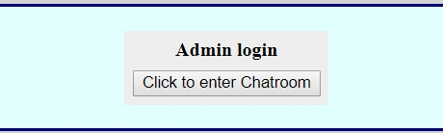
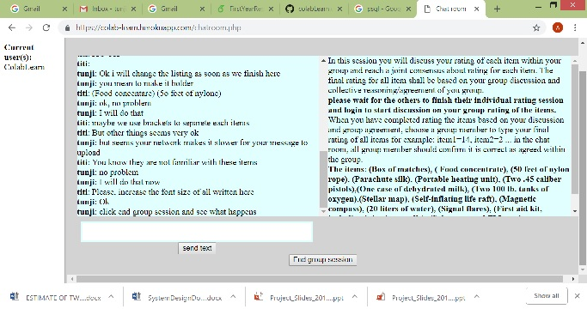
JPSD Chat-room System Algorithm and Interface
The c1Frame.div2 (sidebar.php) display the list of participants/learners in the chat-room.
Let’s chat in JPSD chat-room@: https://colab-learn.herokuapp.com/admin2.php.
sidebar.php
Session start
If: session.username isSet AND
session.groupname isSet AND
session.currentG isSet
currentGrp:= session.currentG
require: loginScript :=> database
query:Select ALL From currentGrp
rowsReturned:= fetchAllRow[query.result]
c2Frame.div: = rowsReturned[username]
See code @:
https://github.com/colabLearn/colabLearn.github.io/blob/master/insert.php

Slide 10
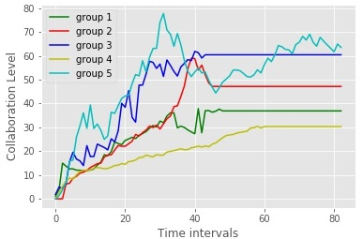
JPSD Chat-room Research Application:
Model-based time series plot of between-groups collaboration measure
Real-time simulation of visualisation dashboard:
http://localhost:8888/notebooks/myProject/simTest.ipynb

Slide 11
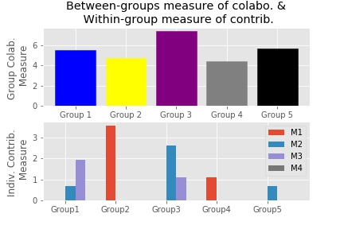
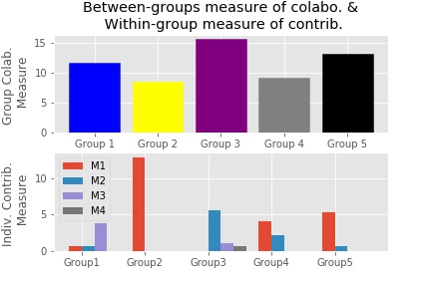
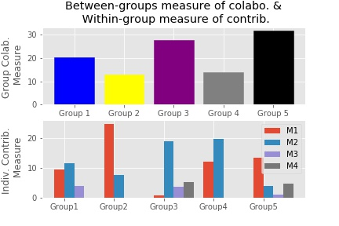
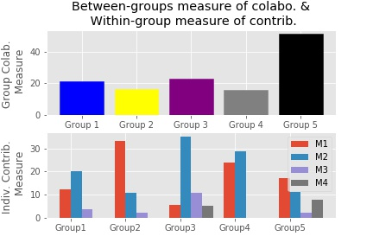
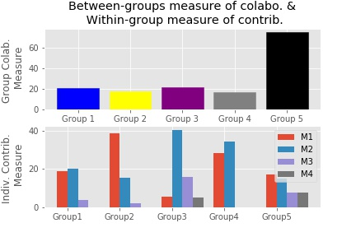
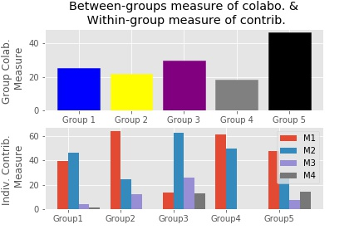
Model-based time series visualization: Between groups collaboration
& Within group individual participation
t1
t2
t3
t4
t5
t6

Slide 12
JPSD Chat-room: Research Application
Further Application in research and Development:
Investigating how to Support for groups to enhance collaboration.
Evaluating effect of support intervention to group collaboration.
Design of robust environment that support online group learning, to further improve cognitive outcome of e-learning system
THANK YOU FOR LISTENING

